Slide 1
SQL Views
CS542

Slide 2
What is a View
An SQL query that we register (store) inside the database
Any query can be a view
CREATE VIEW <name> AS <select statement>;
DROP VIEW <name>;
ProfNumStudents is a view with schema (pNumber, CNT)
CREATE VIEW ProfNumStudents AS
  SELECT pNumber, count(*) AS CNT
  FROM Student
  GROUP BY pNumber;

Slide 3
Why Need a View: I
Frequent queries: query is used again and again
Complex queries: query written once and stored in the database
CREATE VIEW StudentInfo AS
  SELECT sNumber, sName
  FROM Student S, Registration R, Professor P
  Where <many conditions>
  Group By ….
  Having …;
Write this complex query once
And store it in the DB

Slide 4
Why Need a View: II
Logical data independence: the base table may change but the view is still the same
Student (sNumber, sName, sAddress, sMajor)
CREATE VIEW StudentBasicInfo AS
  SELECT sNumber, sName
  FROM Student;
We need only sNumber and sName
Code that queries table Student may need to change because the output schema has changed.
Alter table Student drop column sMajor;
Any code that queries the view will not change because the view output is still the same.

Slide 5
Why Need a View: III
Hide information (Security): allow users to see the view but not the original tables
Student (sNumber, sName, sAddress, sMajor, SSN)
CREATE VIEW StudentNo_SSN AS
  SELECT sNumber, sName, sAddress, sMajor
  FROM Student;
This view hides the SSN column

Slide 6
View Schema
Think of a view as a table, but it gets its data during runtime
  Only the definition is stored without data
View Schema
  Consists of the columns produced from the select statement
CREATE VIEW ProfNumStudents AS
  SELECT pNumber, count(*) AS CNT
  FROM Student
  GROUP BY pNumber;
ProfNumStudents(pNumber, CNT)
CREATE VIEW StudentBasicInfo AS
  SELECT sNumber, sName
  FROM Student;
StudentBasicInfo(sNumber, sName)

Slide 7
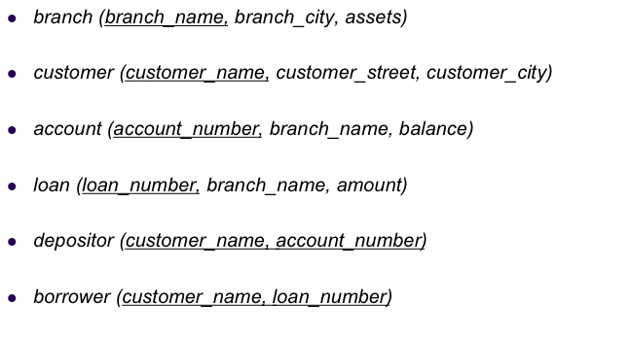
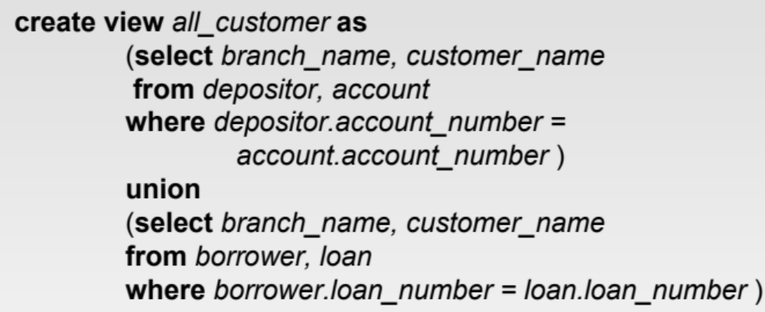
Example
Customers who have accounts
Customers who have loans

Slide 8

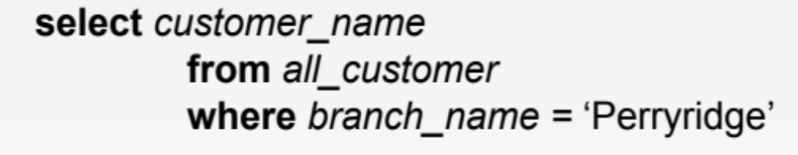
Querying a View
Exactly as querying a table
all_customer(branch_name, customer_name)
Query the view

Slide 9
View Execution: Naïve way
1
Execute the view and store the output in temporary table
Temp table:
all_customer(branch_name, customer_name)
Not the way the DB does it….
2
Execute the user’s query
Produce output
3
Delete the temporary table

Slide 10
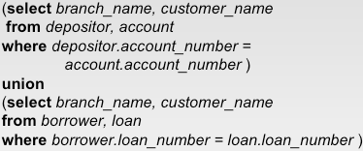
View Execution: Actual Way
1
Replace the view name with its definition
Select customer_name
From
Where branch_name = ‘Perryridge’;
all_customer
2
Optimize the query
This condition can move inside the two select statements

Slide 11


View Execution: Actual Way
3
Re-write the query and execute
Select customer_name
From
Conditions will even execute before the joins
And branch_name = ‘Perryridge’)
And branch_name = ‘Perryridge’) all_customer;

Slide 12
Summarizing Views
1- Register query and store it in DB
2- Only query definition is stored (not data)
CREATE VIEW StudentInfo AS
  SELECT sNumber, sName
  FROM Student S, Registration R, Professor P
  Where <many conditions>
  Group By ….
  Having …;
4- Why need it:
- Storing complex queries
- Security (hide information)
- Logical Independence
3- Referenced in other queries like any other table in the DB

Slide 13
Views Examples
CREATE VIEW <viewName> as <query>
CREATE VIEW studentProfessor (student, professor) AS
SELECT sName, pName
FROM Student, Professor
WHERE Student.professor = Professor.pNumber;
DROP VIEW studentProfessor;
CS542

Slide 14
Views - Example
Student
Professor
sNumber | sName | address | professor
1 | Dave | 320FL | 1
2 | Greg | 320FL | 1
3 | Matt | 320FL | 2
pNumber | pName | address
1 | MM | 235FL
2 | ER | 241FL
CREATE VIEW studentProfessor (student, professor) AS
SELECT sName, pName
FROM Student, Professor
WHERE Student.professor = Professor.pNumber;
student | professor
Dave | MM
Greg | MM
Matt | ER
SELECT * from studentProfessor;
CS542

Slide 15
Views - Example
Student
Professor
sNumber | sName | address | professor
1 | Dave | 320FL | 1
2 | Greg | 320FL | 1
3 | Matt | 320FL | 2
pNumber | pName | address
1 | MM | 235FL
2 | ER | 241FL
student | professor
Dave | MM
Greg | MM
Matt | ER
CREATE VIEW studentProfessor (student, professor) AS
SELECT sName, pName
FROM Student, Professor
WHERE Student.professor = Professor.pNumber;
advisees | professor
2 | MM
1 | ER
SELECT professor, count(*) as advisees
FROM studentProfessor
GROUPBY professor;
CS542

Slide 16
Querying Views
CREATE VIEW studentProfessor (student, professor) AS
SELECT sName, pName
FROM Student, Professor
WHERE Student.professor = Professor.pNumber;
student | professor
Dave | MM
Greg | MM
Matt | ER
SELECT pnumber as professor, count(*)
FROM Student, Professor
WHERE Student.professor =
Professor.pNumber
GROUPBY professor;
SELECT professor, count(*)
FROM studentProfessor
GROUPBY professor;
CS542

Slide 17
Updating Views
Consider views defined with only one relation in the FROM clause such as:
CREATE VIEW MyStudent(num,name)AS
SELECT sNumber, sName
FROM Student;
Question: Are these views updatable? How ?
Answer: Updating these views is done by updating the underlying Student base tables.
CS542

Slide 18
Updating Single Relation Views
DELETE FROM MyStudent WHERE name=`Dave';
-- This will delete corresponding row from Student table
DELETE FROM Student WHERE name=`Dave';
This update is valid !
CS542

Slide 19
Updating Single Relation Views
INSERT INTO MyStudent VALUES (4, `Mary’);
-- This will be translated to:
INSERT INTO Student (sNumber, sName) VALUES (4, `Mary’);
-- What happens to other values of Student tuple ?
CS542

Slide 20
Inserting into single relation views
CREATE VIEW MyStudent1(name)
AS SELECT sName FROM Student;
INSERT INTO MyStudent1 VALUES (‘Mary’)
will be translated to:
INSERT INTO Student(sName) VALUES (‘Mary’).
This will return an error as sNumber is primary key, i.e., it must not be null.
CS542

Slide 21
Updating Single Relation views
What about views with DISTINCT ? Updatable?
CREATE VIEW MyStudent2(name) AS
SELECT DISTINCT sName
FROM Student;
CREATE VIEW MyStudent3(num) AS
SELECT DISTINCT sNumber
FROM Student;
If the SELECT clause specifies DISTINCT, then the view is not updatable.
CS542

Slide 22
Updating Single Relation Views
WHERE clause may specify subqueries.
CREATE VIEW MyStudent4 (num, name) AS
SELECT sNumber, sName
FROM Student
WHERE sName IN
(SELECT pName FROM Professor);
-- Insert into this view will insert into Student table
CS542

Slide 23
Multiple Relation Views: Delete
Updating this multi-relation view?
CREATE VIEW studentProf (studentname, profname)
AS SELECT sName, pName
FROM Student, Professor
WHERE SName = PName;
-- Ambigious what base table to update !
-- Side effects as other tuples may disappear out of the view !
CS542

Slide 24
Multi-Relation View
Deletes can be done against multi-relation views if there is a table with same key as the view.
CS542

Slide 25
Views - Example
Student
Professor
sNumber | sName | address | professor
1 | Dave | 320FL | 1
2 | Greg | 320FL | 1
3 | Matt | 320FL | 2
pNumber | pName | address
1 | MM | 235FL
2 | ER | 241FL
student | profname
1 | MM
2 | MM
3 | ER
CREATE VIEW studentProfessor (student, profname) AS
SELECT sNumber, pName
FROM Student, Professor
WHERE Student.professor = Professor.pNumber;
pNumber is key in Professor
sNumber is key of Student
student is key of view
What is key in
studentProfessor table?

Slide 26
Multi-Relation View
Reminder : Deletes can be done against multi-relation views if there is a table such that the view and table have same key.

Slide 27
Deleting from multi-relation views
Try following update statements:
DELETE FROM studentProfessor WHERE profname ='MM';
-- What will be deleted ?
CS542

Slide 28
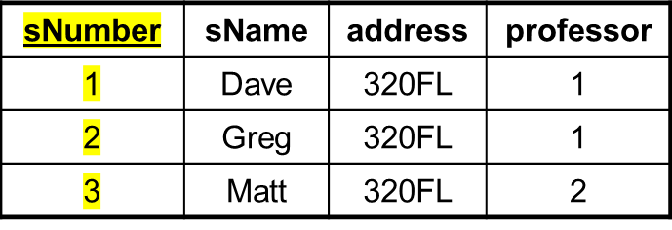
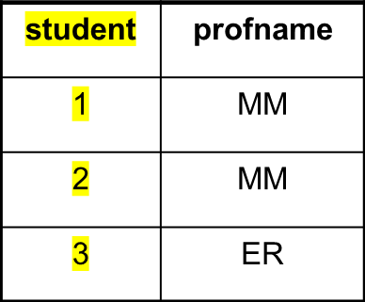
Views - Example
Student
Professor
pNumber | pName | address
1 | MM | 235FL
2 | ER | 241FL
CREATE VIEW studentProfessor (student, professor) AS
SELECT sNumber, pName
FROM Student, Professor
WHERE Student.professor = Professor.pNumber;
DELETE FROM studentProfessor WHERE profname='MM';
-- This will actually delete the two rows in Student table.
CS542

Slide 29
Inserting into multi-relation views
Consider view definition:
CREATE VIEW studentProf(student, professor)
AS SELECT sNumber, pName FROM Student, Professor
WHERE professor=pNumber;
INSERT INTO Studentprof(student) VALUES (4);
-- the above insert will succeed; put into Student table
INSERT INTO Studentprof VALUES (4, 'ER');
-- THIS ABOVE INSERT WILL FAIL AS IT TRIES TO INSERT INTO Professor TABLE AS WELL.
CS542

Slide 30
Inserting into multi-relation views
Insert will succeed only if
  The insert translates to insert into only one table.
  The key for the table to be inserted will also be a key for the view.

Slide 31
Views - Summary
Views are useful – Virtual relations
Querying through views is always possible
CS542

